Slide 1

Natural Language Processing
Recitation Class

Slide 2
Recap
Language Model: A system that predicts the next word
Recurrent Neural Network: A family of neural networks that:
Take sequential input of any length
Apply the same weights on each step.
Can optionally produce output on each step
Problems: Vanishing and exploding gradient
LSTM: Solution of Vanishing gradient
Gradient Clipping: Solution for Exploiding gradient
GRUs are similar to Long Short-Term Memory (LSTM)

Slide 3
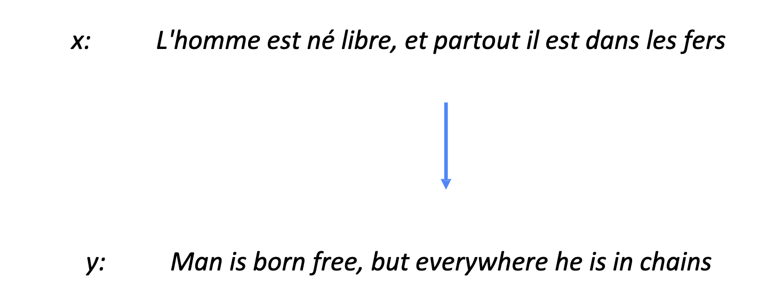
Machine Transplation
Machine translation is the automated process of translating text or speech from one language to another using computer algorithms.

Slide 4
What is alignment
Alignment in the context of natural language processing, machine translation, and text analysis refers to the process of associating words or phrases in one language with their corresponding words or phrases in another language. This alignment is crucial for various tasks, such as machine translation, parallel text alignment, and extracting bilingual data for training translation models.

Slide 5
Example of alignment:
English Sentence: "I have a red car."
French Sentence: "J'ai une voiture rouge."
The word alignment might look like this:
"I" aligns with "J'ai"
"have" aligns with "une"
"a" aligns with "voiture"
"red" aligns with "rouge"
"car" aligns with "voiture"

Slide 6
Continuation:
This alignment indicates which words in the English sentence correspond to which words in the French sentence. It's a basic example of word alignment, but in real-world applications, the alignment process becomes more complex, especially for languages with different word orders, word forms, and grammatical structures.
In machine translation, alignment models and algorithms are used to learn and generate these associations automatically from parallel text data. The resulting alignments are then used to train translation models, which can produce accurate translations from one language to another.

Slide 7
Neural Machine Translation
Neural machine translation (NMT) is a state-of-the-art approach to machine translation that uses neural networks to translate text from one language to another. NMT has revolutionized machine translation by offering improved translation quality and fluency.

Slide 8
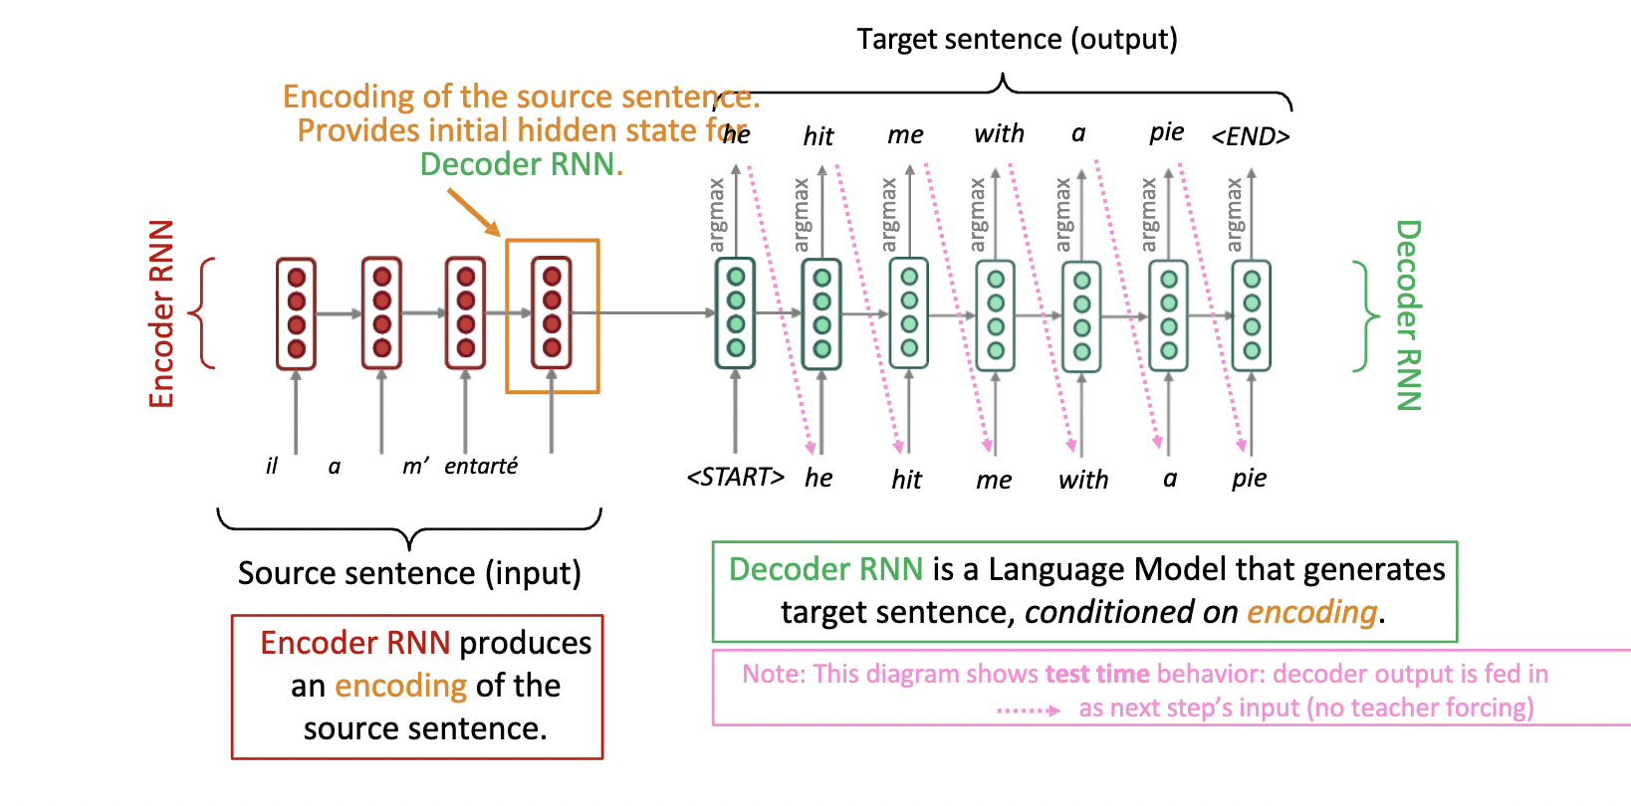
Principles of Neural Machine Translation:

Slide 9
1 Principle: Sequence-to-Sequence Architecture:
NMT is based on a sequence-to-sequence (Seq2Seq) model. This model consists of two main components: an encoder and a decoder.
Encoder: The encoder takes the input text (source language) and converts it into a fixed-length vector, known as the context vector or thought vector. It processes the entire input sequence simultaneously and captures the contextual information.
Decoder: The decoder takes the context vector produced by the encoder and generates the output text (target language) one word at a time. It uses the context vector to condition its predictions, taking into account the context of the source sentence.

Slide 10
Example: English-to-French Translation using Seq2Seq:
Suppose we want to translate the English sentence "I have a red car" into French using a Seq2Seq model.
Step 1: Encoding (English to Context Vector)
The encoder takes each word in the English sentence and processes it one at a time.
It updates its hidden state based on the input word and the previous hidden state.
The encoder produces a context vector that summarizes the entire English sentence.

Slide 11
Continuation:
Step 2: Decoding (Context Vector to French)
The decoder takes the context vector and an empty initial hidden state.
It starts generating the translation one word at a time, conditioned on the context vector.
For the first time step, the decoder predicts the word "J'ai" (I have) based on the context vector.
It then continues generating the translation word by word, considering the context of the English sentence to produce "une voiture rouge" (a red car).
The Seq2Seq architecture is highly versatile and can be used for a wide range of sequence-to-sequence tasks beyond translation, including chatbots, text summarization, and more. Training a Seq2Seq model involves using large datasets with paired input and output sequences, enabling the model to learn the mapping between input and output data effectively.

Slide 12
Greedy decoding
Greedy decoding is a decoding strategy often used in sequence-to-sequence models, such as neural machine translation and text generation, to generate output sequences one element at a time.
In greedy decoding, at each step, the model selects the element (e.g., a word or token) that has the highest predicted probability based on its current context. This means the model makes locally optimal decisions at each step, without considering the global context or future elements in the sequence. Greedy decoding is computationally efficient but may not always result in the best overall sequence, as it might make suboptimal choices early in the generation process.

Slide 13
Example: Model Input: "The quick"
Step 1: The model predicts the next word based on the input. Let's say the highest probability prediction is "brown."
Input: "The quick"
Prediction: "The quick brown"
Step 2: Now, the model updates its input to include the newly predicted word and predicts the next word.
Input: "The quick brown"
Prediction: "The quick brown fox"
Step 3: The process continues, and the model keeps predicting the next word based on the current input.
Input: "The quick brown fox"
Prediction: "The quick brown fox jumps"
Input: "The quick brown fox jumps"
Prediction: "The quick brown fox jumps over”
This process continues until the model generates an end token (e.g., a period), reaches a predefined maximum sequence length, or stops based on other criteria.

Slide 14
Advantages:
Simplicity and ease of implementation.
Low latency for real-time applications.
Deterministic output for reproducibility.

Slide 15
Disadvantages:
Suboptimal results due to local decision-making.
Lack of diversity and repetitive output.
Inflexibility for handling constraints.
Risk of error propagation with incorrect early decisions.
Limited exploration of alternative sequences.
Greedy decoding has no way to undo decisions!
How to fix this? Next slide

Slide 16
Beam Search Decoding
Beam search is a popular decoding strategy used in sequence-to-sequence models to improve the quality of generated sequences while maintaining computational efficiency. It works by considering multiple candidate sequences at each decoding step, keeping a "beam" of the most likely sequences

Slide 17
Scenario: Generating an English Sentence
Step 1: Initialization
Start with the word "The."
Decide to consider the top 2 candidates at each step (beam width = 2).
Step 2: Expanding the Beam
Generate the next word for "The."
Consider the top 2 most likely next words:
"quick" (with a probability of 0.6)
"lazy" (with a probability of 0.4)
Retain the top 2 candidates based on these probabilities.

Slide 18
Continuation:
Step 3: Repeating the Process
Continue by generating the next word for each candidate and calculating their probabilities.
For example:
"The quick" -> "The quick brown" (with a probability of 0.7)
"The quick" -> "The quick fox" (with a probability of 0.3)
"The lazy" -> "The lazy dog" (with a probability of 0.5)
"The lazy" -> "The lazy cat" (with a probability of 0.5)
Keep the top 2 candidates at each step based on their probabilities.

Slide 19
Continuation:
Step 4: Continuing the Search
Continue generating the next words for each candidate, considering the top 2 likely next words for each.
The beam search process continues, and new candidates replace the lower probability ones.
Step 5: Completion
Continue this process until a predefined stopping condition is met. In this case, let's consider the sentence ending with a period.
Final Output:
Beam search returns the sequence with the highest probability, which might be, for example, "The quick brown”

Slide 20
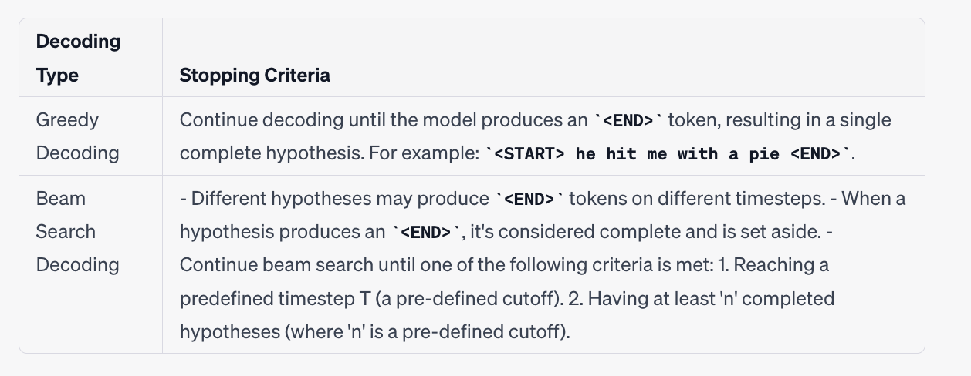

Slide 21
The disadvantages of Neural Machine Translation (NMT) compared to Statistical Machine Translation (SMT) and inherent to NMT are as follows:
Less Interpretable: NMT models are often considered less interpretable than SMT models. It can be challenging to understand how NMT models arrive at their translations, making it harder for linguists and translators to analyze and improve the translation process.
Difficult to Debug: Debugging NMT models can be complex. When translations are incorrect, it can be challenging to pinpoint the cause or error, leading to difficulties in the debugging process.
Lack of Control: NMT systems may offer less control over the translation process. It's often challenging to specify rules or guidelines for translation, which can be critical for maintaining consistency or adhering to specific terminology.
Safety Concerns: NMT models can produce translations that are sensitive, politically biased, or offensive. Ensuring the safety and ethical use of NMT systems is a concern, particularly in public-facing applications.

Slide 22
Evaluation of Machine Translation
BLEU (Bilingual Evaluation Understudy) • BLEU compares the machine-written translation to one or several human-written translation(s), and computes a similarity score based on: • n-gram precision (usually for 1, 2, 3 and 4-grams) • Plus a penalty for too-short system translations • BLEU is useful but imperfect • There are many valid ways to translate a sentence • So a good translation can get a poor BLEU score because it has low n-gram overlap with the human translation

Slide 23
2 Principle: Recurrent Neural Networks (RNNs) and Transformers:
NMT models can be built using recurrent neural networks (RNNs) or more recently, using the Transformer architecture. Transformers have become the dominant architecture for NMT due to their parallel processing capabilities and superior performance.

Slide 24
3 Principle: Attention Mechanism:
NMT models often incorporate attention mechanisms, allowing the model to focus on different parts of the input sequence while generating the output. This helps improve translation quality and handle long sentences effectively.

Slide 25

Thank you.

